Slide 1
Frontend Development

Slide 2
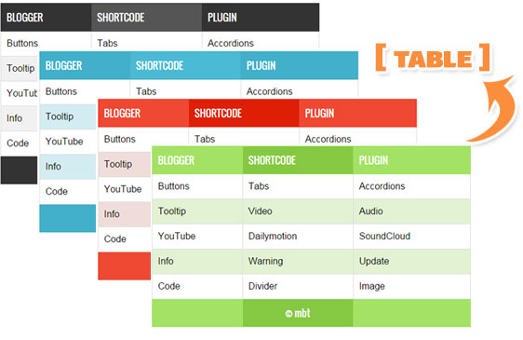

Slide 3
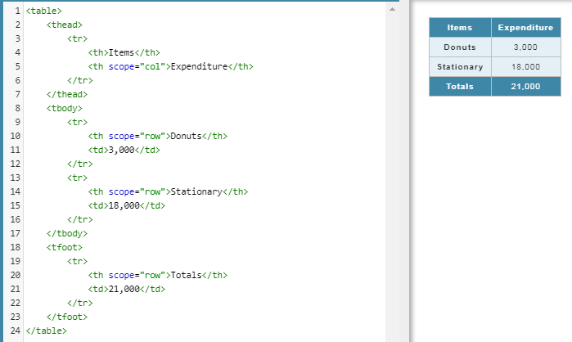
Table

Slide 4
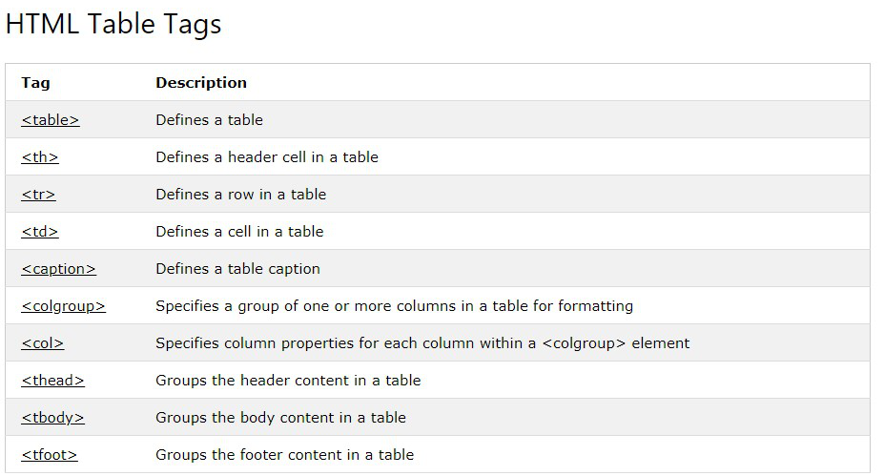

Slide 5
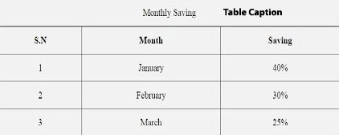
Table Caption

Slide 6
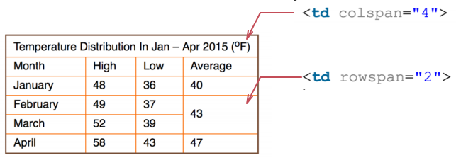
colspan | rowspan

Slide 7

Assignment
Make a school class timetable which has merged cells.

Slide 8
References
https://developer.mozilla.org/en-US/docs/Web/HTML/Element/base
https://developer.mozilla.org/en-US/docs/Web/HTML/Element/table
https://developer.mozilla.org/en-US/docs/Web/HTML/Element/tbody
https://developer.mozilla.org/en-US/docs/Web/HTML/Element/thead
https://developer.mozilla.org/en-US/docs/Web/HTML/Element/tfoot
https://developer.mozilla.org/en-US/docs/Web/HTML/Element/tr
https://developer.mozilla.org/en-US/docs/Web/HTML/Element/td
https://developer.mozilla.org/en-US/docs/Web/HTML/Element/th
https://developer.mozilla.org/en-US/docs/Web/HTML/Element/colgroup
https://developer.mozilla.org/en-US/docs/Web/HTML/Element/caption

